Slide 1

Hoardr
Team: 160 Zaibatsu
Chris Nguyen
Sean Papay
Dakota Polenz
Ryan Lichtig

Slide 2
Hoardr
Design: Back-End
A single table – Cards, contains data for every card.
We have another table – Users, that contains information on our users
Each user has a collection, which is a table that contains a list of card references.
Each user also has a decklist, which contains a number of references to decks, each of which contains a list of card references.

Slide 3
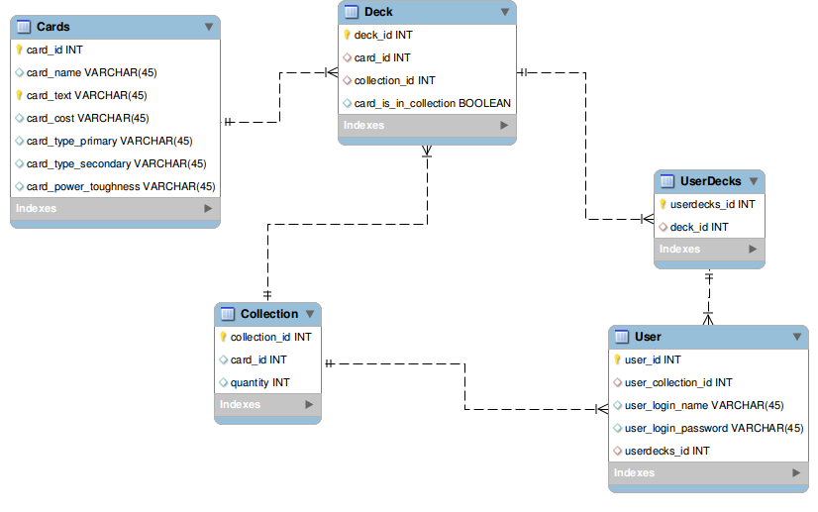
Hoardr
EER Diagram

Slide 4
Hoardr
Design: Front-End
Page design and layout will be created using bootstrap, with some use of javascript for interactive page elements.
Dynamic content will use JSPs to populate the page from information in the database.
User input will be handled within Java, which will update the database as needed.

Slide 5
Hoardr
Design: User Interface
Search Bar, both simple and advanced.
- Simple: Card Name
- Advanced: Card Color, Type, Primary/Secondary . Types(?)
A user homepage that is unique per user.
More pages to allow the user to see their decks and collection.
Visible statistics for various items at different points.

Slide 6
Hoardr
Implementation Plan
Our first priority in our application is the construction and population of our database.
The views and user interface will also be of a high priority since we want our application to be easily used by everyone.
Our controllers will be developed at the same point as our views and time will be split evenly between the two sets of classes

Slide 7
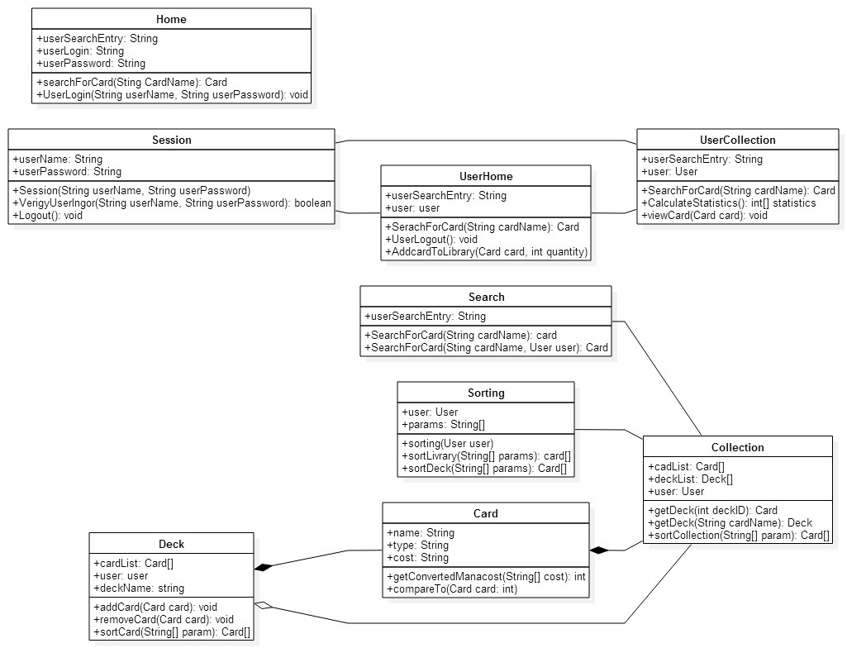
Hoardr
UML Diagram

Slide 8
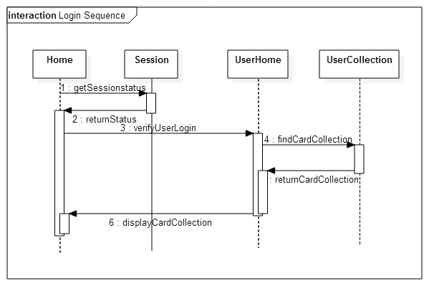
Hoardr
Login Sequence Diagram

Slide 9
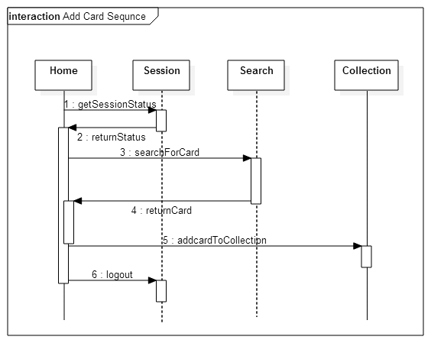
Hoardr
Add Card Sequence Diagram

Slide 10
Hoardr
Gantt Chart

